Slide 1
ARGUMENTATIVE ESSAY
This essay present a clear thesis statement and provide evidence and reasoning to support a specific viewpoint or argument.

Slide 2
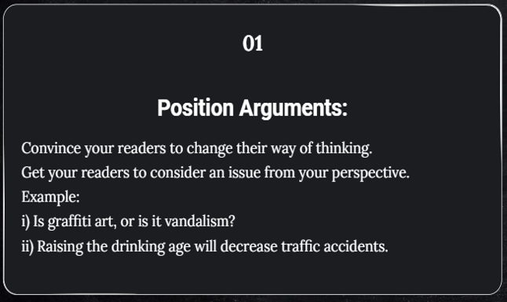
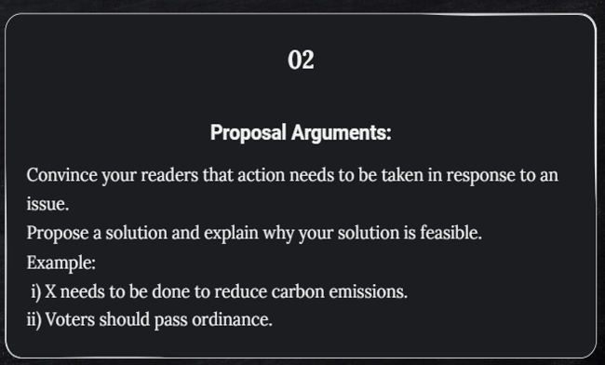
Position Vs Proposal

Slide 3



Argumentation Techniques: Understanding Ethos, Pathos & Logos

Slide 4

Examples of Ethos: Illustrating trust & credibility in communication

Slide 5
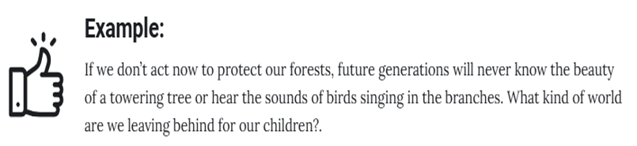
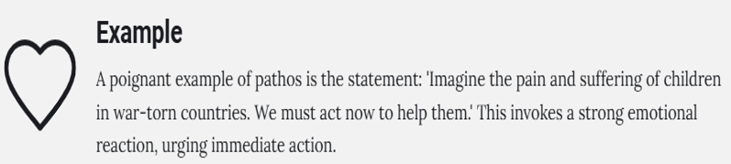
Example of Pathos: Understanding emotional connection

Slide 6

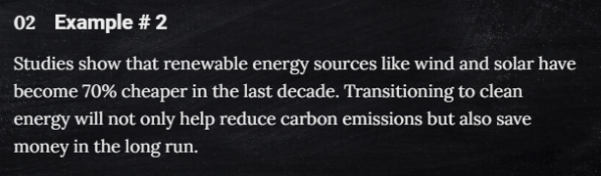
Examples of Logos:

Slide 7

Understanding Logical Appeal

Slide 8
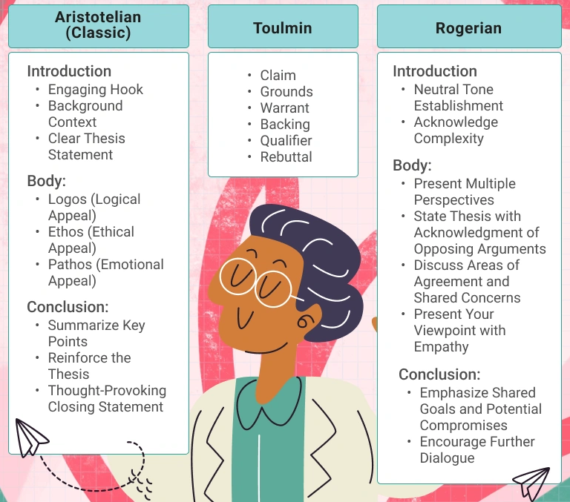
Techniques of Writing an argumentative essay

Slide 9
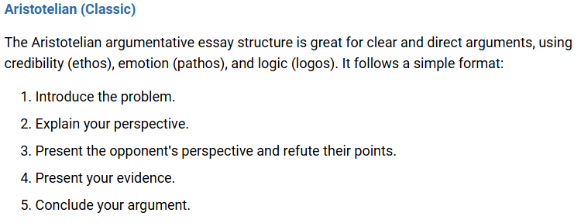
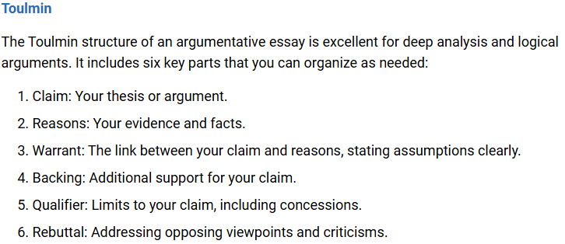

Slide 10
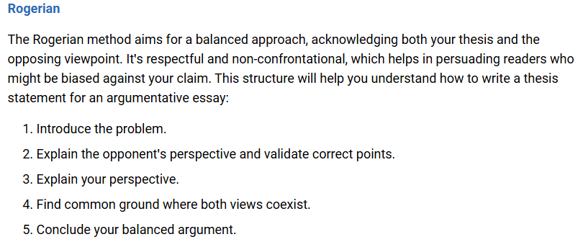

Slide 11
Pattern of writing the essay is mentioned on page # 142 & 143

